Slide 1
Chapter 22
Elementary Graph Algorithms
Sun-Yuan Hsieh
謝孫源 教授
成功大學資訊工程學系

Slide 2

Outline
Graph representation
Breadth-first search
Depth-first search
Topological sort
Strongly connected components

Slide 3
Graph representation
Given graph G = (V, E).
May be either directed or undirected.
Two common ways to represent for algorithms:
  Adjacency lists.
  Adjacency matrix.

Slide 4
When expressing the running time of an algorithm, it’s
often in terms of both |V| and |E|.
In asymptotic notation − and only in asymptotic notation −
we’ll drop the cardinality.
Example: Ο(V+E).

Slide 5
Adjacency lists
Array Adj of |V| lists, one per vertex.
Vertex u’s list has all vertices v such that (u, v) ∈ E.
(Works for both directed and undirected graphs.)
Example: For an undirected graph:
Adj
1
2
5
/
1
2
2
1
5
4
3
/
3
3
2
4
/
5
4
4
2
5
3
/
5
4
1
2
/

Slide 6
Adjacency lists
If edges have weights, can put the weights in the lists.
Weight: w : E → R
Space: Θ(V+E)
Time: to list all vertices adjacent to u: Θ(degree(u))
Time: to determine if (u, v) ∈ E: Ο(degree(u))

Slide 7
Example: For a directed graph:
Adj
1
2
1
2
/
2
4
/
3
1
/
3
4
4
4
3
/
Same asymptotic space and time

Slide 8
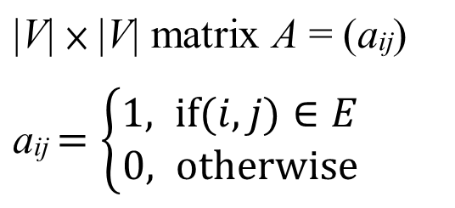
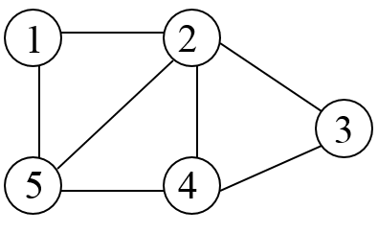
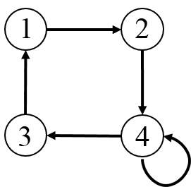
Adjacency matrix
1
2
3
4
5
1
0 1 0 0 1
2
1 0 1 1 1
3
0 1 0 1 0
4
0 1 1 0 1
5
1 1 0 1 0
1
2
3
4
1
0 1 0 0
2
0 0 0 1
3
1 0 0 0
4
0 0 1 1
Space: Θ(V²)
Time: to list all vertices adjacent to u: Θ(V)
Time: to determine if (u, v) ∈ E: Θ(1)
Can store weights instead of bits for weighted graph

Slide 9
Breadth-first search
Input: Graph G = (V,E), either directed or undirected, and
source vertex s ∈ V
Output: d[v] = distance (smallest # of edges) from s to v,
for all v ∈ V
Also π[v] = u such that (u, v) is last edge on a shortest path
s → v
  u is v’s predecessor
  set of edges {(π[v], v) : v ≠ s} forms a tree

Slide 10
Breadth-first search
Idea: Send a wave out from s.
First hits all vertices 1 edge from s.
From there, hits all vertices 2 edges from s.
Etc.
Use FIFO queue Q to maintain wavefront.
v ∈ Q if and only if wave has hit v but has not come out of v yet.

Slide 11
(a)
r
s
t
u
(b)
r
s
t
u
0
1
0
1
v
w
x
y
v
w
x
y
Q
s
Q
w
r
0
1
1
(c)
r
s
t
u
(d)
r
s
t
u
1
0
2
1
0
2
1
2
2
1
2
v
w
x
y
v
w
x
y
Q
r
t
x
Q
t
x
v
1
2
2
2 2
2

Slide 12
(e)
r
s
t
u
(f)
r
s
t
u
1
0
2
3
1
0
2
3
2
1
2
2
1
2
3
v
w
x
y
v
w
x
y
Q
x
v
u
Q
v
u
y
2
2
3
2
3
3
(g)
r
s
t
u
(h)
r
s
t
u
1
0
2
3
1
0
2
3
2
1
2
1
3
2
3
2
2
v
w
x
y
v
w
x
y
Q
u
y
y
3
3
3

Slide 13
(i)
r
s
t
u
1
0
2
3
2
1
3
2
2
v
x
v
w
y
Q

Slide 14
BFS(V, E, s)
for each u ∈ V – {s}
do d[u] ← ∞
d[s] ← 0
Q ←φ
ENQUEUE(Q, s)
While Q ≠ φ
do u ← DEQUEUE(Q)
for each v ∈ Adj[u]
do if d[v] = ∞
then d[v] ← d[u] + 1
ENQUEUE(Q, v)

Slide 15
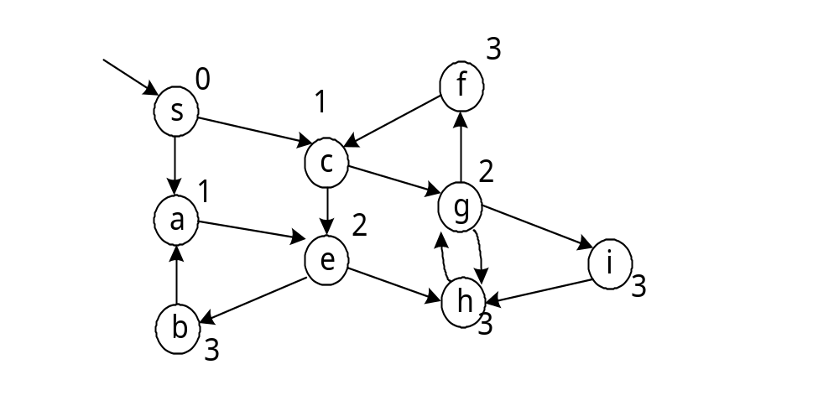
Example: directed graph
Can show that Q consists of vertices with d values.
i i i …. i i+1 i+1 … i+1
Only 1 or 2 values.
If 2, differ by 1 and all smallest are first.

Slide 16
Since each vertex gets a finite d value at most once, values
assigned to vertices are monotonically increasing over time.
BFS may not reach all vertices.
Time = O(V + E).
O(V) because every vertex enqueued at most once.
O(E) because every vertex dequeued at most once and we examine (u, v) only when u is dequeued. Therefore, every edge examined at most once if directed, at most twice if undirected.

Slide 17

Depth-first search
Input: G = (V, E), directed or undirected. No source vertex
given!
Output: 2 timestamps on each vertex:
  d[v] = discovery time
  f [v] = finishing time
  These will be useful for other algorithms later on.
  Can also compute π[v].

Slide 18
Will methodically explore every edge.
Start over from different vertices as necessary.
As soon as we discover a vertex, explore from it.
Unlike BFS, which puts a vertex on a queue so that we explore from it later.

Slide 19
As DFS progresses, every vertex has a color:
WHITE = undiscovered
GRAY = discovered, but not finished (not done exploring from it)
BLACK = finished (have found everything reachable from it)
Discovery and finish times:
Unique integers from 1 to 2|V|.
For all v, d[v] < f[v].
In other words, 1 ≤ d[v] < f[v] ≤ 2|V|.

Slide 20
Discovery time
(a)
u
v
w
(b)
u
v
w
1/
1/
2/
x
y
z
x
y
z
(c)
u
v
w
(d)
u
v
w
1/
2/
1/
2/
3/
4/
3/
x
y
z
x
y
z

Slide 21
(e)
u
v
w
(f)
u
v
w
1/
2/
1/
2/
B
B
4/
3/
4/5
3/
x
y
z
x
y
z
(g)
u
v
w
(h)
u
v
w
1/
2/
1/
2/7
B
B
4/5
3/6
4/5
3/6
x
y
z
x
y
z

Slide 22
(i)
u
v
w
(j)
u
v
w
1/
2/7
1/8
2/7
F
B
B
F
4/5
3/6
4/5
3/6
x
y
z
x
y
z
(k)
u
v
w
(l)
u
v
w
1/8
2/7
9/
1/8
2/7
9/
F
B
F
B
C
4/5
3/6
4/5
3/6
x
y
z
x
y
z

Slide 23
(m)
u
v
w
(n)
u
v
w
1/8
2/7
9/
1/8
2/7
9/
F
B
C
B
C
F
B
4/5
3/6
10/
4/5
3/6
10/
x
y
z
x
y
z
(o)
u
v
w
(o)
u
v
w
1/8
2/7
9/
1/8
2/7
9/12
F
B
C
F
B
C
B
B
4/5
3/6
10/11
4/5
3/6
10/11
x
y
z
x
y
z

Slide 24
Pseudocode: Uses a global timestamp time.
DFS(V,E)
for each u ∈ V
do color[u] ← WHITE
time ← 0
for each u ∈ V
do if color[u] = WHITE
then DFS - Visit(u)

Slide 25
DFS - Visit(u)
color[u] ← GRAY  discover u
time ← time +1
d[u] ← time
for each v ∈ Adj[u]  explore (u, v)
do if color[v] = WHITE
then DFS - Visit(v)
color[u] ← BLACK
time ← time +1
f[u] ← time  finish u

Slide 26
Example:
d
f
T
C
1
12
8
11
13
16
T
T
C
T
B
F
C
2
7
9
10
T
C
T
3
4
5
6
14
15
C
C
Time = Θ(V + E).
Similar to BFS analysis.
Θ, not just O, since guaranteed to examine every
vertex and edge.

Slide 27
DFS forms a depth-first forest comprised of ≥ 1 depth-first trees.
Each tree is made of edges (u, v) such that
u is gray and v is white when (u, v) is explored.

Slide 28
Theorem (Parenthesis theorem)
[Proof omitted.]
For all u, v, exactly one of the following holds:
d[u] < f[u] < d[v] < f[v] or d[v] < f[v] < d[u] < f[u] and neither of u and v is a descendant of the other.
d[u] < d[v] < f[v] < f[u] and v is a descendant of u.
d[v] < d[u] < f[u] < f[v] and u is a descendant of v.
So d[u] < d[v] < f[u] < f[v] cannot happen.
Like parentheses:
OK: ( ) [ ] ( [ ] ) [ ( ) ]
Not OK: ( [ ) ] [ ( ] )
Corollary
v is a proper descendant of u if and only if
d[u] < d[v] < f[v] < f[u].

Slide 29
(a)
y
z
s
t
3/6
2/9
1/10
11/16
B
F
C
B
4/5
7/8
12/13
14/15
C
C
C
u
x
w
v
(b)
s
t
z
v
u
y
w
x
1 2 3 4 5 6 7 8 9 10 11 12 13 14 15 16
( s (z (y (x x) y) (w w) z) s) (t (v v) (u u) t)

Slide 30
Theorem (White-path theorem)
[Proof omitted.]
v is a descendant of u if and only if at time d[u], there is a
path u → v consisting of only white vertices.
(Except for u, which was just colored gray.)
Classification of edges
Tree edge: in the depth-first forest.
Found by exploring (u, v).
Back edge: (u, v), where u is a descendant of v.
Forward edge: (u, v), where v is a descendant of u, but not a tree edge.
Cross edge: any other edge. Can go between vertices in the same depth-first tree or in different depth-first trees.

Slide 31
In an undirected graph, there may be some ambiguity
since (u, v) and (v, u) are the same edge. Classify by the
first type above that matches.
Theorem [Proof omitted.]
In DFS of an undirected graph, we get only tree and
back edges. No forward or cross edges.

Slide 32

Topological sort
Directed acyclic graph (dag)
A directed graph with no cycles.
Good for modeling processes and structures that have a
partial order:
a > b and b > c a > c.
But may have a and b such that neither a > b nor b > a.
Can always make a total order
(either a > b or b > a for all a ≠ b) from
a partial order. In fact, that’s what a topological sort will do.

Slide 33
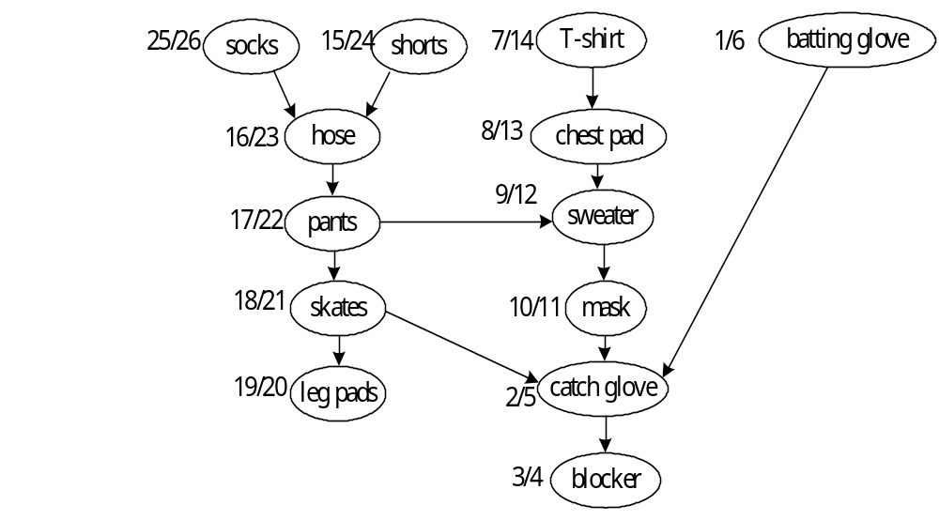
Example: dag of dependencies for putting on goalie equipment:

Slide 34
Topological sort
  定義：
  A topological sort of a dag G=(V, E) is a linear ordering of all its vertices. (dag: Directed acyclic graph) 如 edge(u, v), u appears before v in the ordering
undershirts
11/16
socks
17/18
watch
9/10
pants
12/15
shoes
13/14
shirt
1/8
belt
tie
2/5
6/7
jacket
3/4
socks
undershirts
pants
shoes
watch
shirt
belt
tie
jacket

Slide 35
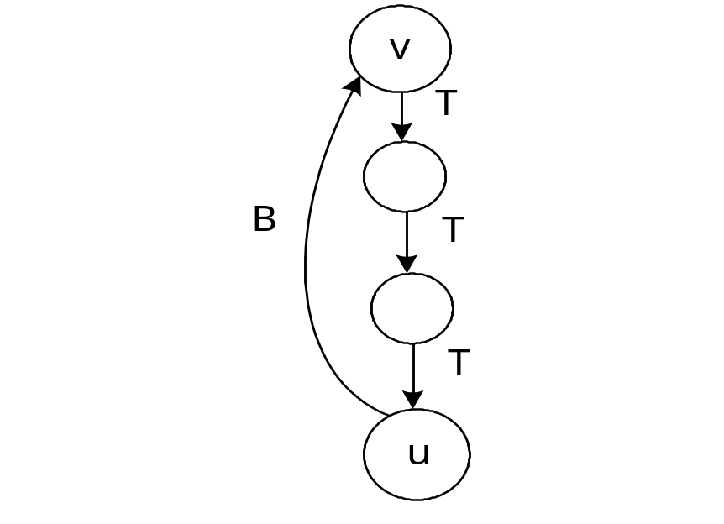

Lemma
A directed graph G is acyclic if and only if a DFS
of G yields no back edges.
Proof ( ): Show that back edge cycle.
Suppose there is a back edge (u, v).
Then v is ancestor of u in depth-first forest.
Therefore, there is a path v → u, so v → u → v is a cycle.

Slide 36

( ) :
Show that cycle back edge.
Suppose G contains cycle c.
At time d[v], vertices of c form a white path v → u
(since v is the first vertex discovered in c).
By white-path theorem, u is descendant of v in
depth-first forest.
Therefore, (u, v) is a back edge.

Slide 37
Topological sort of a dag: a linear ordering of vertices
such that if (u, v)∈E, then u appears somewhere before v.
(Not like sorting numbers.)
TOPOLOGICAL-SORT(V, E)
call DFS(V, E) to compute finishing times f[v] for all v ∈ V
output vertices in order of decreasing finish times

Slide 38
Don’t need to sort by finish times.
Can just output vertices as they’re finished and understand that we want the reverse of this list.
Or put them onto the front of a linked list as they’re finished. When done, the list contains vertices in topological sorted order.
Time: Θ(V+E)

Slide 39
Order:
socks
shorts
hose
pants
21 skates
20 leg pads
14 t-shirt
13 chest pad
12 sweater
11 mask
6 batting glove
5 catch glove
4 blocker

Slide 40
Correctness: Just need show if (u, v) ∈ E, then f[v] < f[u].
When we explore (u, v), what are the colors of u and v?
u is gray.
Is v gray, too?
  No, because then v would be ancestor of u.
  (u, v) is a back edge.
  contradiction of previous lemma (dag has no back edges).

Slide 41
Is v white?
  Then becomes descendant of u.
  By parenthesis theorem, d[u] < d[v] < f[v] < f[u].
Is v black?
  Then v is already finished.
  Since we’re exploring (u, v), we have not yet finished u.
  Therefore, f[v] < f[u].

Slide 42

Strongly connected components
Given directed graph G = (V,E).
A strongly connected component (SCC) of G is a
maximal set of vertices C V such that for all u, v ∈ C,
both u → v and v → u.
Example: [Just show SCC’s at first. Do DFS a little later.]
14/19
15/16
3/4
1/12
6/9
17/18
13/20
2/5
10/11
7/8

Slide 43
Algorithm uses G^{T} = transpose of G.
G^{T} = (V, E^{T}), E^{T} = {(u, v) : (v, u) ∈ E}.
G^{T} is G with all edges reversed.
Can create G^{T} in Θ(V + E) time if using adjacency lists.
Observation: G and G^{T} have the same SCC’s.
(u and v are reachable from each other in G if and only
if reachable from each other in G^{T}.)

Slide 44
Component graph
G^{SCC} = (V^{SCC}, E^{SCC}).
V^{SCC} has one vertex for each SCC in G.
E^{SCC} has an edge if there’s an edge between the corresponding SCC’s in G.
For our example:
14/19
15/16
3/4
1/12
6/9
17/18
13/20
2/5
10/11
7/8

Slide 45
Lemma
G^{SCC} is a dag. More formally, let C and C’ be distinct
SCC’s in G, let u, v ∈ C, u’, v’ ∈ C’, and suppose there is
a path u → u’ in G. Then there cannot also be a path v’→
v in G.
Proof Suppose there is a path v’→ v in G. Then there are
paths u → u’ → v’ and v’ → v → u in G. Therefore,
u and v’ are reachable from each other, so they are
not in separate SCC’s.

Slide 46
SCC(G)
call DFS(G) to compute finishing times f[u] for all u
compute G^{T}
call DFS(G^{T}), but in the main loop, consider vertices in order of decreasing f[u]
(as computed in first DFS)
output the vertices in each tree of the depth-first forest formed in second DFS
as a separate SCC

Slide 47
Example:
Do DFS
G^{T}
DFS (roots blackened)
14/19
15/16
3/4
1/12
6/9
17/18
13/20
2/5
10/11
7/8
Time: Θ(V + E).

Slide 48


14/
C
14/19
15/16
15/
3/
3/4
B
1/
1/12
6/
6/9
B
B
F
17/
13/
2/
10/11
2/5
10/
7/
17/18
13/20
7/8
B
C
C
3/
3/4
6/
6/7
10/
10/13
9/
9/14
17/
17/20
2/
15/16
2/5
1/
1/8
11/12
11/
15/
18/
18/19

Slide 49
How can this possibly work?
Idea: By considering vertices in second DFS in
decreasing order of finishing times from first
DFS, we are visiting vertices of the component
graph in topological sort order.
To prove that it works, first deal with 2 notational issues:
Will be discussing d[u] and f[u]. These always refer to first DFS.
Extend notation for d and f to sets of vertices U V :
  d(U) = min_{u∈U} {d[u]} (earliest discovery time)
  f(U) = max_{u∈U} {f[u]} (latest finishing time)

Slide 50
Lemma
Let C and C’ be distinct SCC’s in G = (V, E). Suppose
there is an edge (u, v) ∈ E such that u ∈ C and v ∈ C’.
C
C’
u
v
Then f(C) > f(C’).

Slide 51
Proof
Two cases, depending on which SCC had the first
discovered vertex during first DFS.
If d(C) < d(C’), let x be the first vertex discovered in C. At time d[x], all vertices in C and C’ are white. Thus, there exist paths of white vertices from x to all vertices in C and C’.
By the white-path theorem, all vertices in C and C’ are descendants of x in depth-first tree.
By the parenthesis theorem, f[x] = f(C) > f(C’).

Slide 52

If d(C) > d(C’), let y be the first vertex discovered in C’. At time d[y], all vertices in C’ are white and there is a white path from y to each vertex in C’ all vertices in C’ become descendants of y.
Again, f[y] = f(C’).
At time d[y], all vertices in C are white.
By earlier lemma, since there is an edge (u, v), we cannot have a path from C’ to C.
So no vertex in C is reachable from y.
Therefore, at time f[y], all vertices in C are still white.
Therefore, for all w ∈ C, f[w] > f[y], which implies that f(C) > f(C’).

Slide 53

Corollary
Let C and C’ be distinct SCC’s in G = (V, E). Suppose
there is an edge (u, v) ∈ E^{T}, where u ∈ C and v ∈ C’.
Then f(C) < f(C’).
Proof (u, v) ∈ E^{T} (v, u) ∈ E. Since SCC’s of G
and G^{T} are the same, f(C’) > f(C).
Corollary
Let C and C’ be distinct SCC’s in G = (V, E), and
suppose that f(C) > f(C’).
Then there cannot be an edge from C to C’ in G^{T}.
Proof It’s the contrapositive of the previous corollary.

Slide 54
Why the SCC procedure works:
❑ When we do the second DFS, on G^{T}, start with SCC C
such that f(C) is maximum.
• The second DFS starts from some x ∈ C, and it
visits all vertices in C.
• Corollary says that since f(C) > f(C’) for all C’ ≠ C,
there are no edges from C to C’ in G^{T}.
Therefore, DFS will visit only vertices in C.

Slide 55
❑ The next root chosen in the second DFS is in SCC C’ such that f(C’) is maximum over all SCC’s other than C. DFS visits all vertices in C’, but the only edges out of C’ go to C, which we’ve already visited.
Each time we choose a root for the second DFS, it can reach only
vertices in its SCC—get tree edges to these,
vertices in SCC’s already visited in second DFS—get no tree edges to these.
We are visiting vertices of (G^{T})^{SCC} in reverse of
topologically sorted order.

